Slide 1

Twitter Sentiment Analysis

Slide 2

Introduction
Welcome to Sentiment Analysis Project. Let's dive into the fascinating world of sentiments hidden within text! Imagine us as detectives, uncovering the emotions behind every word. Get ready to decode the sentiments behind 1.6 million tweets. Let’s explore the power of emotions in the digital realm.

Slide 3

Problem Statement
Categorize Tweets: Sort tweets into positive, negative, or neutral categories using sentiment analysis.
Calculate Average Polarity: Determine average polarity scores per sentiment category to gauge overall positivity/negativity.
Display Sentiment Distribution: Showcase proportions of positive, negative, and neutral sentiments in tweets.

Slide 4
Data Collection
Sentiment Analysis dataset stands as a pivotal resource for understanding sentiment within social media content.
Source: https://www.kaggle.com/datasets/kazanova/sentiment140
Scale: The substantial size of 1.6 million tweets amplifies its significance for comprehensive sentiment analysis.
This dataset includes labeled tweets with sentiments categorizing them into positive, and negative classifications.

Slide 5

Libraries and Tools
Python
NumPy
Pandas
Matplotlib
Seaborn
NLTK (Natural Language Toolkit)
Word Cloud
Scikit Learn

Slide 6

What is Sentiment Analysis?
Sentiment analysis decodes human emotions through text data
Reveals opinions and nuances, enriching language understanding
Algorithms reveal patterns beyond simple positive/negative sentiments
Captures complexities in expressions, providing valuable insights
Vital for businesses, extracting information from social media, reviews, and news
Challenges include context, sarcasm, and evolving tech for better comprehension

Slide 7

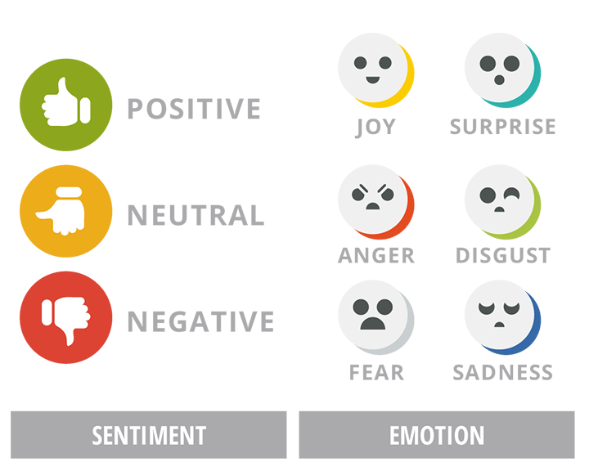
Sentiment Analysis

Slide 8
Models Used
Linear Regression: Applies linear relationships for sentiment prediction.
Naive Bayes: Probability-based classification for efficient handling of large datasets.
Random Forest: Ensemble method capturing complex relationships.
Support Vector Classifier: Creates decision boundaries in high-dimensional space for binary classification tasks.

Slide 9
Why NLTK?
Toolkit features: NLTK encompasses text processing tools like tokenization, stemming, lemmatization, parsing, with diverse algorithms.
Educational Resources: Widely embraced in education for NLP due to comprehensive documentation and examples.
Community Support: Robust support via forums and resources from NLTK's strong community.
Open-source flexibility: Customizable and freely available for tailored research or project needs.
Multilingual capacity: Accommodates diverse languages, ideal for various language-based NLP tasks.

Slide 10
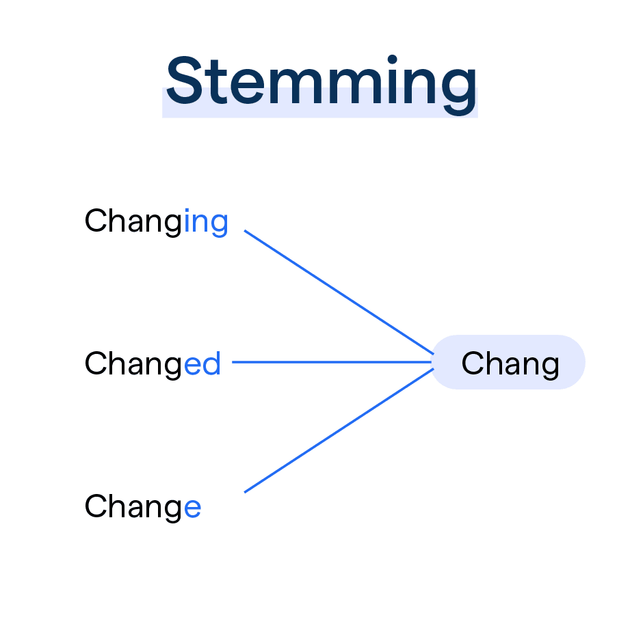
Stemming
Reducing words to their base or root form to normalize text.
Aids in simplifying variations of words to their common base.
Helps in grouping similar words, but may not preserve original word meaning.
Useful in sentiment analysis for broader pattern recognition but may lack nuance.

Slide 11
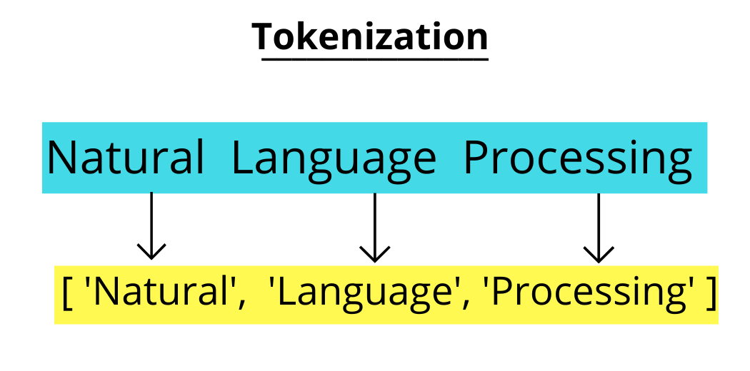
Tokenization
Tokenization is the process of breaking text into words or tokens.
NLTK’s tokenization guides us, revealing the essence of each tweet.
A crucial step in understanding the sentiment.

Slide 12
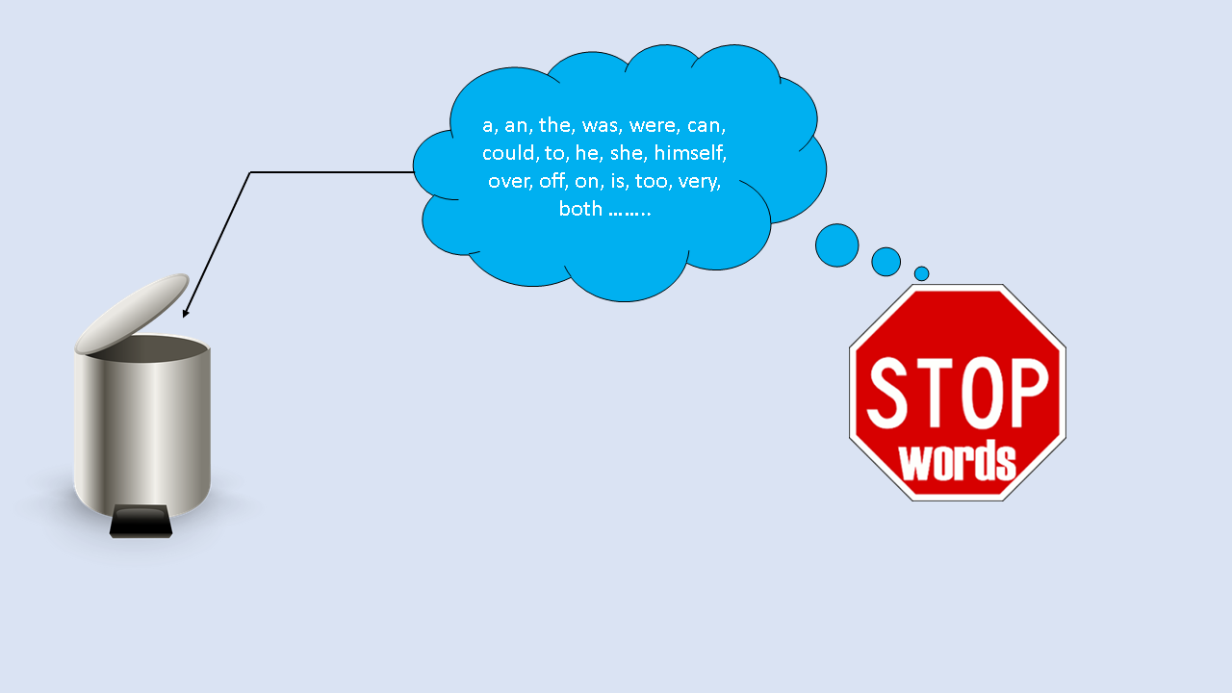
Stopwords
Stopwords are common words, but they clutter our path.
NLTK helps us clear the way by removing these common distractions.
To focus on meaningful words with sentiment.

Slide 13
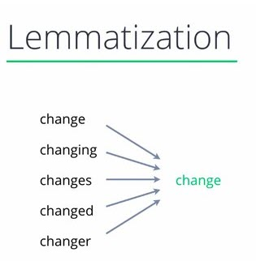
Lemmatization
Converts words to base or dictionary form, considering grammar and context.
Example: "Running" becomes "run," preserving meaning through reduction.
Utilizes part-of-speech (POS) tagging for precise transformations.
Enhances text comprehension and comparison in analysis tasks.
More resource-intensive than stemming due to dictionary lookup and context analysis.

Slide 14
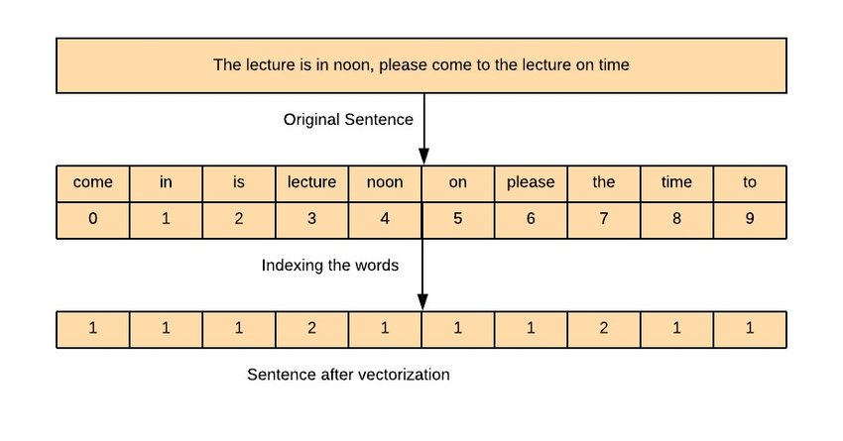
Vectorization
Text to Numbers: Converts text into numerical representations.
Vector Space Model: Assigns numerical vectors to words in a high-dimensional space.
Techniques: Bag-of-Words (BoW), TF-IDF, Word Embeddings (e.g., Word2Vec, GloVe).
BoW: Represents text using word frequency counts, turning documents into count-based vectors.
TF-IDF: Considers term importance by weighing word frequency against corpus frequency.
Word Embeddings: Maps words into dense vectors, capturing semantic relationships.

Slide 15
Polarity and Subjectivity
Polarity means how positive or negative the text is the value of polarity lies between -1 to 1 negative value indicates that the sentiment is not good positive value indicates that the sentiment is good
Subjectivity means statement or opinion or piece of text influenced by personal feelings The value of subjectivity relates to whether it is a public opinion or its factual information the value of subjectivity lies between 0 to 1.

Slide 16
Word Cloud
Represents frequent words visually based on their occurrence in the text.
Larger words indicate higher frequency, offering a quick overview.
Highlights significant terms related to different sentiments like positive, negative, or neutral.
Enhances understanding by showcasing prevalent words in the dataset.
Engages audience visually, aiding in insights and pattern recognition.
Provides an efficient way to comprehend textual data at a glance.

Slide 17
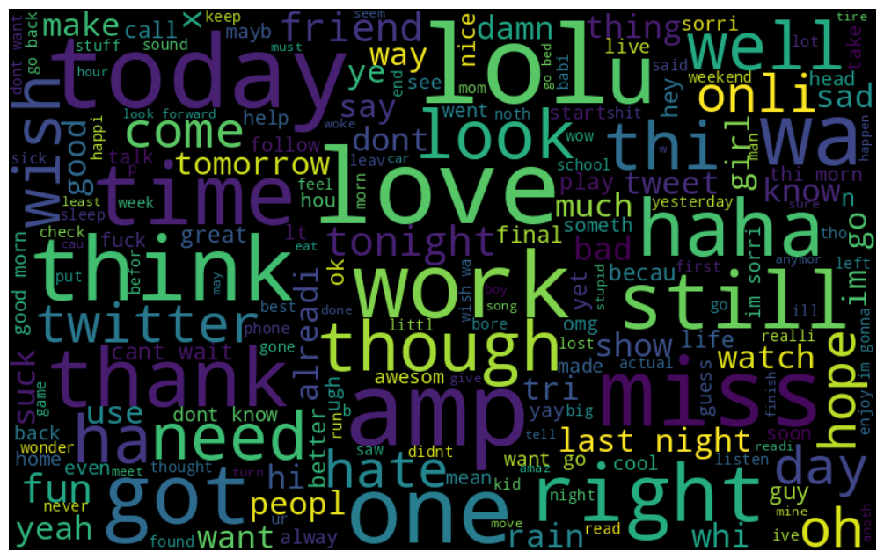
Frequent Words in Tweets

Slide 18
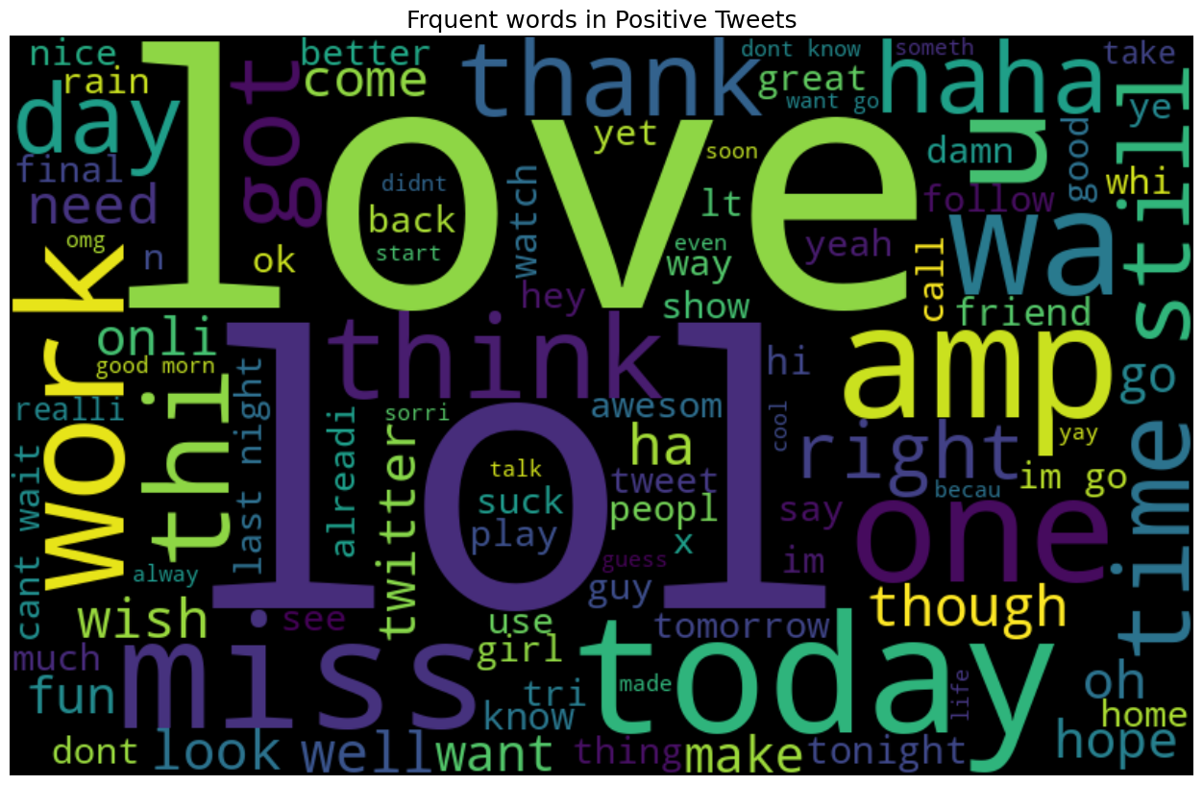
Positive Tweets

Slide 19
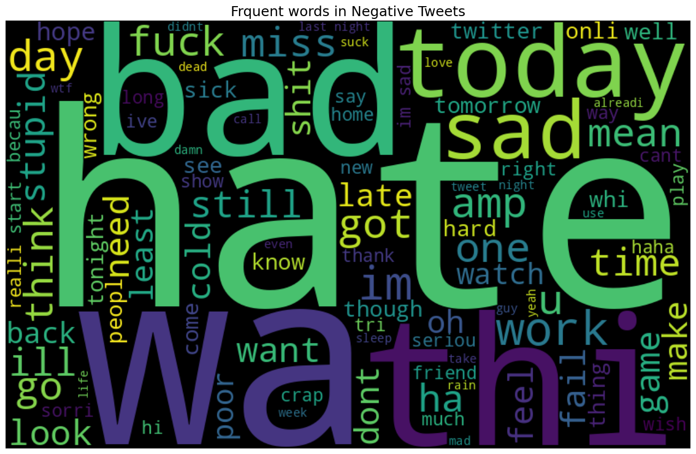
Negative Tweets

Slide 20
Sentiment by Polarity

Slide 21
Sentiment by Average Polarity

Slide 22
Sentiment Analysis By Tweets

Slide 23
Sentiment By Sum & Average Polarity

Slide 24
Sentiment By Total Polarity

Slide 25
Conclusion
Categorized tweets into sentiment categories.
Calculated the average polarity within each category.
Visualized sentiment distribution and polarity trends.
Explored the emotional landscape of the digital world.

Slide 26

Thank You!.

